Slide 1
TEAM-4
- By Srinu

Slide 2
Project TITLE
BOOK RECOMMENDATION SYSTEM

Slide 3
Problem statement
The main objective of this project is generate the features from the dataset and use them to recommend the books accordingly to the users.

Slide 4
EXPLORATORY DATA ANALYSIS

Slide 5
At first, import the required python libraries
-Pandas ((used for data analysis)
-Numpy (used for working with arrays)
-Matplotlib (used for visual representation like plotting graphs)
-Seaborn (used for data visualization and exploring data analysis

Slide 6
DATASET INFORMATION
The dataset is comprised of 3 csv files:-
-Books dataset
-Ratings dataset
-Users dataset

Slide 7
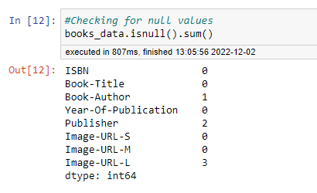
Insigths from Books dataset
There are 3 null value columns in the books_data
They are:- Book-Author
-Publisher
-Image-URL-L
So, drop these null value columns
from the dataset

Slide 8
Imputation of null values
Fill Nan values in the ‘Book-Author’ and ‘Publication’ with ‘No Mention’.
Why?
- Because we can’t replace Book-Author and Publisher with other names. So, using ‘No mention’ to fill the Nan values

Slide 9
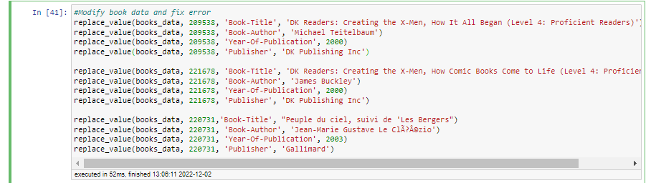
Correcting the mismatched columns
There are two string values i.e., DK Publishing and Gallimard are appeared in the Year-Of-Publication column.This leads to invalid results.
Lets make it correct by using the following code.

Slide 10
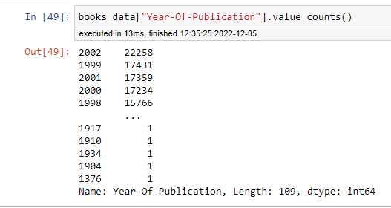
Treatment on Year of publication column
In the Year-Of-Publication columns, Years 0 & 2022 are invalid years. Replacing this invalid years with max year.
Max year in the Year-Of-Publication column is 2002. So, replace invalid years with 2002.
Why replacing with max year?
-Because most number of publications
takesplace in this year(2002). So, that’s
the reason to replace with max year.

Slide 11
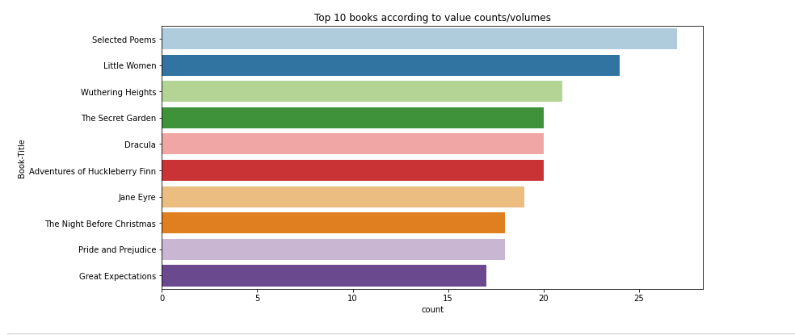
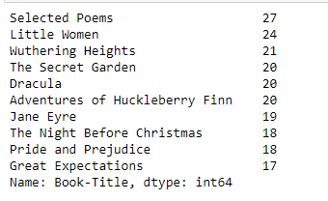
TOP 10 BOOKS ACCORDING TO VOLUMES
Selected poems has the highest no.of volumes(27), followed by Little Women,
Wuthering Heights …..acc. to given dataset

Slide 12
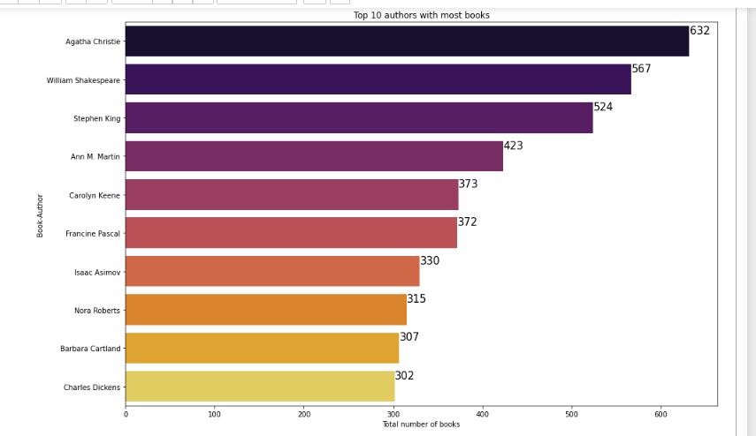
Top 10 authors with most no.of Books
Agatha Christie wrote the highest no.of books (632), then followed by
William Shakespeare,……….according to given dataset(Books).

Slide 13
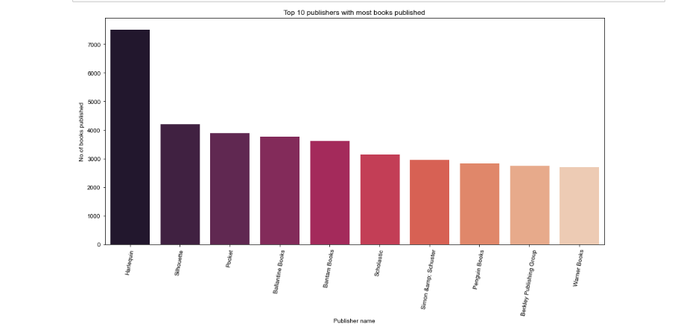
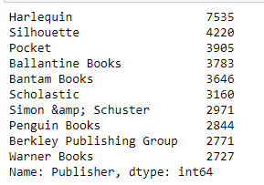
TOP 10 PUBLISHERS WITH MOST BOOKS PUBLISHED
Harlequin published highest no.of books (7535), followed by Silhoette, Pocket,….according to given dataset

Slide 14
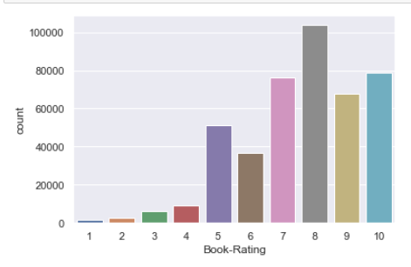
INSIGHTS FROM RATINGS DATASET
Ratings starts from 0 tom10
Ratings‘0’ means users doesn’t rate/read the book.
Ratings otherthan 0 i.e., from 1 to 10 means rated the book .
So, I divided ratings column into 2 categories.
-Ratings implicit(0-rating) and Ratings explicit(1-10 ratings).
Ignoring the Ratings implicit category, because
we can’t recommend books on 0 ratings.
Among the Ratings explicit(1-10), rating 8 has been
rated the highest no.of times

Slide 15
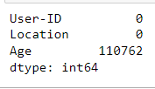
INSIGHTS FROM USERS DATASET
Age column has ~40% null values that means there are 110762 empty age values in the 278858(total age values) of users dataset.

Slide 16
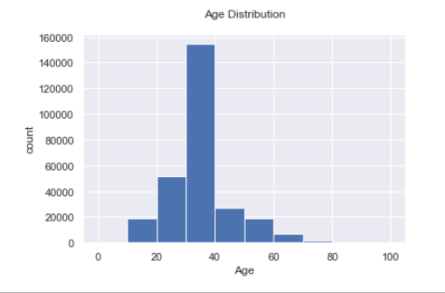
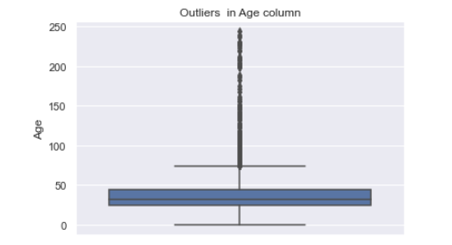
Outliers detection and Treatment of Nan values
Plotting a boxplot for age column to detect outliers .
By observing the boxplot, Age below 10 and above 80 can be treated as outliers.
Age has positive skewness, So we can use median to fill outliers and Nan values.
From distribution plot, most no.of users lies in between 30-40years of age.

Slide 17
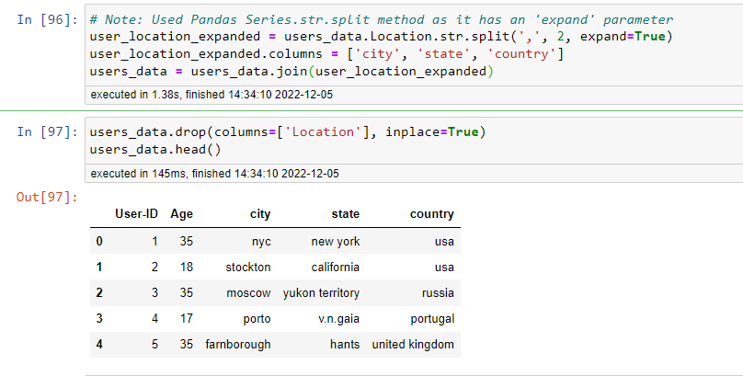
TREATMENT OF LOCATION COLUMN
Split the location column into City, State and Country columns by using the below code.

Slide 18
IMPUTATION OF Country column
There are 4561 entries with empty stringsa and 2 Nan entries in the Country column.
So, replacing empty strings with Nan.
Why?
- Data type of country column is object , There is no other ways to replace empty string values. So that’s why replacing empty strings in the country column with Nan entries

Slide 19
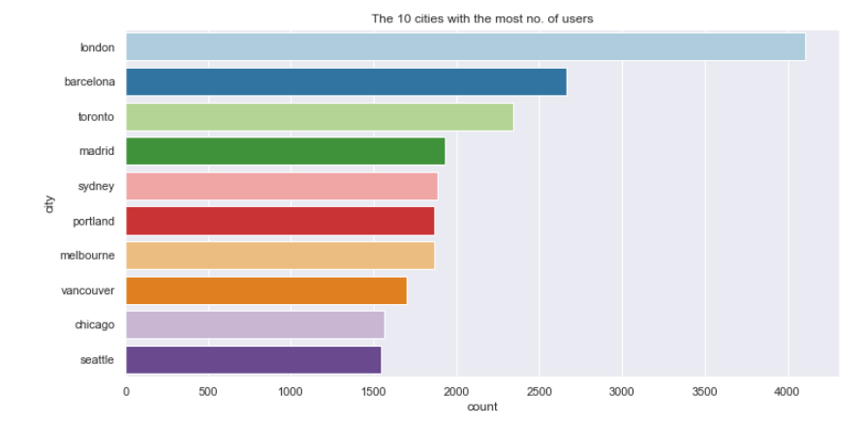
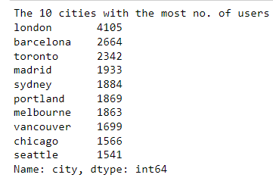
TOP 10 CITIES WITH MOST NO.OF USERS
London has the most no.of users (4105) among the Top 10 cities.

Slide 20
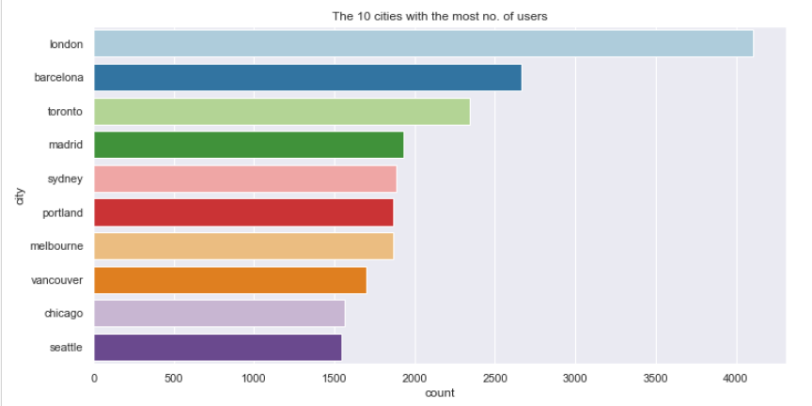
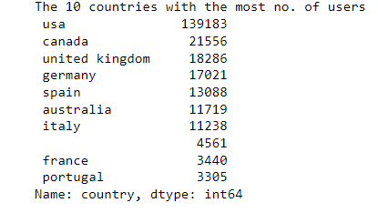
Top 10 countries with most no.of users
U.S.A has the most no.of users (139183) among the Top 10 Countries.

Slide 21
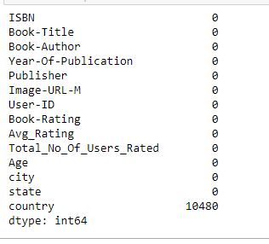
Merging datasets
After Data cleaning, merge three datasets on their respective similar columns.
After merging, the size of the dataset is 383842 rows and 14 columns.
Only Country column has the null values among the 14 columns

Slide 22
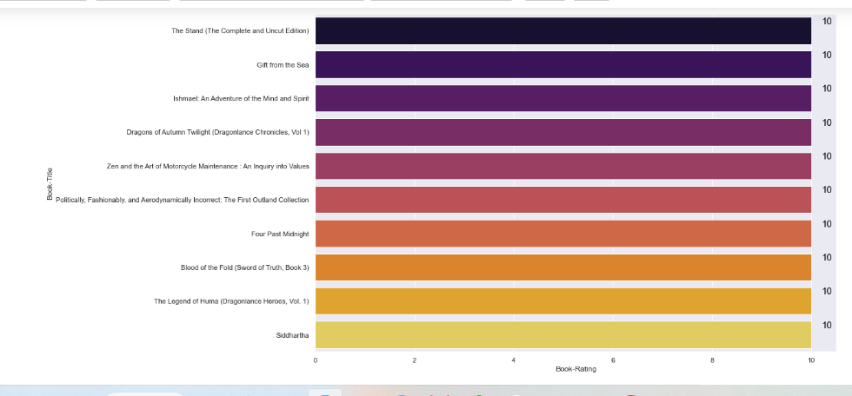
Top 10 Most rated books
The following books ‘The Stand(The Complete and Uncut Edition), Gift from the sea,….. got the highest ratings(10/10).

Slide 23
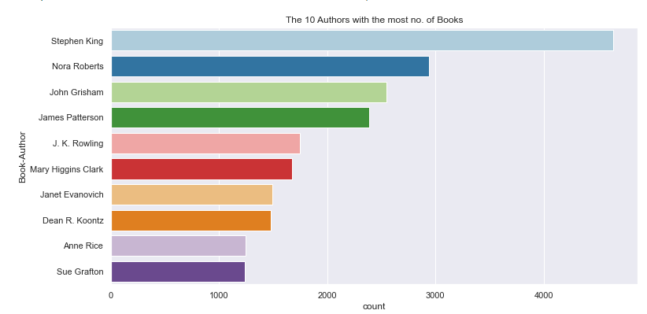
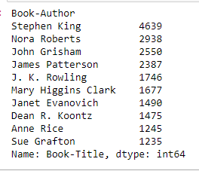
Top 10 most prolifc authors
Stephen King wrote the ,highest no.of books (4569), followed by Nora Roberts,
John Grisham…….

